Slide 1
WEBINAR
Analytical Method Validation for Regulatory Compliant Testing
May 11, 2022, 1:00 PM US Eastern Time Zone
Presenters:
Josh Rhein B.S.
Eurofins, Laboratory Director, BUMa
JoshuaRhein@EurofinsUS.com
Leo Schilling M.Sc.
Eurofins, Senior Scientific Services Manager
LeoSchilling@EurofinsUS.com
Notes:
Hello, and than you for attending today’s webinar!

Slide 2

AGENDA
Introduction
Test Method Selection and
Evaluation of Method Fitness
Method Validations
Method Performance Verifications
Maintaining Compliance

Slide 3
What is method validation?
USP
OECD
US FDA
ISO
Notes:
Method validation is the process of defining an analytical requirement, and confirming that the method under consideration has capabilities consistent with what the application requires. Inherent in this is the need to evaluate the method’s performance. The judgement of method suitability is important; in the past method validation tended to concentrate only on evaluating the performance characteristics.
Method validation is usually considered to be very closely tied to method development. Many of the method performance characteristics that we will discuss today that are associated with method validation are usually evaluated, at least approximately, as part of method development. However, it is important to remember that formal validation of the final version of the method as a documented procedure should be completed.

Slide 4
TERMINOLOGY & DEFINITIONS
VALIDATION
Establishes the performance parameters and suitability of a new or single-laboratory validated method.
Matrix Extension
Extensions of the scope of a validated method require a supplemental validation.
Method Fitness
Confirming that a method performs suitably for a specific matrix.
VERIFICAION
Ensures that a standard or “Official” method is implemented with equivalent performance as previously established in the validation.
Change Control
Changes in laboratory personnel, suppliers and equipment require assessments to demonstrate equivalency.
Method Modification
Changes to a method resulting from alternate equipment or procedures may require validation.
Notes:
VALIDATION
Establishes the performance parameters and suitability of a new or single-laboratory validated method.
Matrix Extension - Extensions of the scope of a validated method require a supplemental validation.
Method Modification - Changes to a method resulting from alternate equipment or procedures may require validation.
VERIFICAION
Ensures that a standard or “Official” method is implemented with equivalent performance as previously established in the validation.
Method Fitness - Confirming that a method performs suitably for a specific matrix.
Change Control - Changes in laboratory personnel, suppliers and equipment require assessments to demonstrate equivalency.

Slide 5
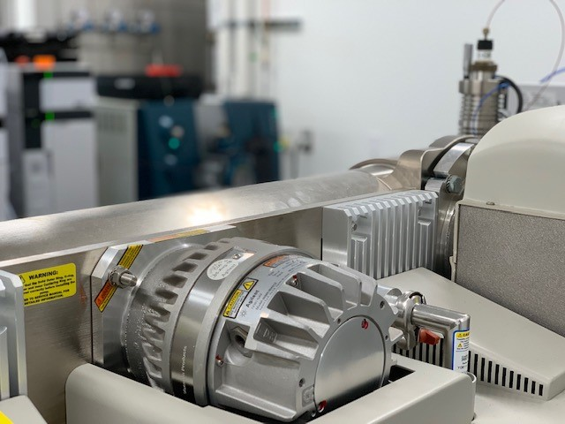



When should methods be validated or verified?
Validation
Development of a new method
Extension to the scope of a previously validated method
Verification
Confirm method applicability to a specific matrix
Demonstrate Proficiency with a newly implemented method
Changes in equipment, components, personnel or suppliers
Modification of equipment, procedure or technique
Notes:
We will be reviewing the differences between validation and verification several times today because it is very common for the wrong terminology to be used. It is important to remember that if you are implementing a previously validated method, then you will either be transferring that method from the reference laboratory or you will “verify under the actual conditions of use” which means in your lab using the equipment and personnel at your facility. Importantly, your lab will not RE-validate, but you will be implementing a validated method.

Slide 6
Why is method validation necessary?
The Importance of Measurement
Establish Performance Parameters for New Methods
Determine Method Suitability
Maintain Process and Quality Control
Notes:
THE IMPORTANCE OF MEASUREMENT
Laboratory testing is a critical necessity that is used in valuing goods, food and feed in the commercial market, supporting healthcare and forensic investigations, checking drinking water, and verification of material specifications.
Decisions that are made based on the results of laboratory testing can sometimes directly impact health and safety related issues.

Slide 7
AGENDA
Introduction
Test Method Selection and
Evaluation of Method Fitness
Method Validations
Method Performance Verifications
Maintaining Compliance

Slide 8
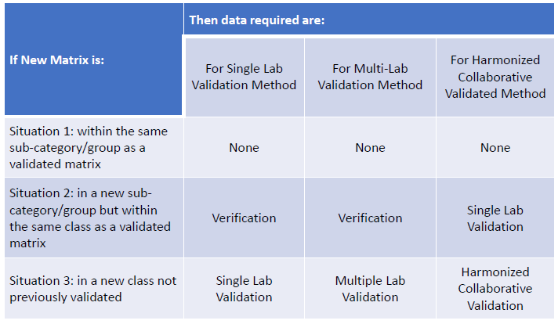
Applicability of the Test Method

Slide 9

Method, Equipment and Instrument Range
Method Selection
Method Evaluation & Record
Notes:
METHOD SELECTION
An integral part of the laboratory quality system is the use of standard methods. Standard methods are used, whenever possible, unless otherwise specified by the Compliance Program or the customer.
Methods of analysis that are specified in law or regulations must be followed in accordance with those requirements.
Non-standard methods are used in cases where a standard method does not exist, and the customer has agreed to its use. A clear expression of quality objectives and testing parameters or criteria are made when a non-standard method is validated.
Equipment that is used for analysis should be calibrated and maintained as specified by the applicable regulations or guidance.
METHOD EVALUATION AND RECORD
Any method selected for use must be appropriate to the requirements of the regulatory function and must be within the capabilities of the laboratory. Analytical methods are to be evaluated based on attributes such as accuracy/trueness, precision, specificity/selectivity, sensitivity, ruggedness/robustness, and practicality.
There shall be a record of evaluation and approval for use in the laboratory by the designated official(s) regardless of whether or not a validation is deemed necessary. The method of evaluation, explanations, and justifications shall be described in the record.

Slide 10
Analytical Sensitivity, Selectivity and Interference
Sensitivity
Selectivity
Interference
Notes:
Sensitivity
Selectivity
The extent to which the method can be used to determine particular analytes in mixtures or matrices without interferences from other components having similar physical properties
Interferences
Spectral, physical, and chemical interferences can be evaluated by analyzing samples containing various suspected interferences. Carryover should be evaluated using the incorporation of blanks immediately following standards and samples.

Slide 11
AGENDA
Introduction
Test Method Selection and
Evaluation of Method Fitness
Method Validations
Method Performance Verifications
Maintaining Compliance

Slide 12
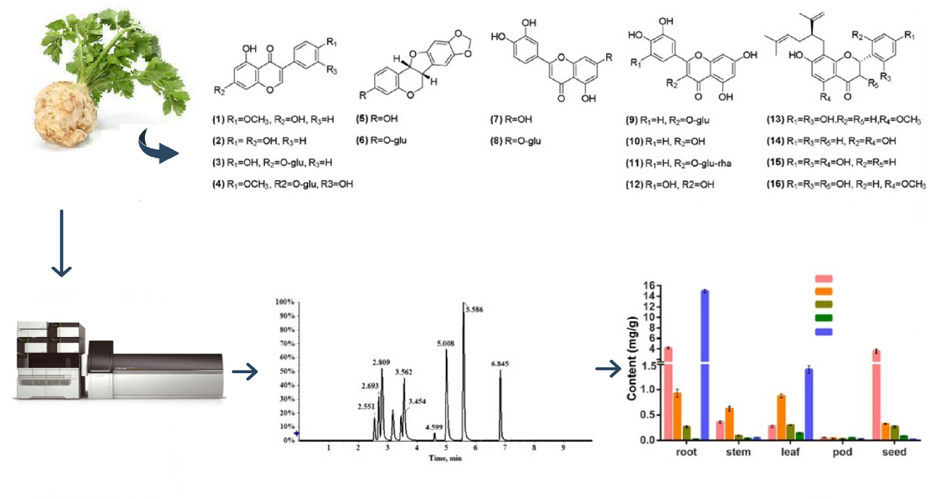
Method Validation
Demonstrate that a new method is fit for purpose.
Non-standard Methods
Modified Standard Methods
Research and Development Methods
Extensions to existing validations
Notes:
There are several reasons to validate a method. It may be because it is a:
Non-standard Method
Research and Development Method
Modified Standard Method
Extension to existing validation, or to
Demonstrate that a new method is fit for purpose.
Only methods that have been developed to the extent that it meets the needs for the purpose of the testing should be validated, and candidate methods should be investigated using experiments to demonstate proof of concept. After the performance specifications have been met, the validation plan is documented and approved before it is executed.

Slide 13

Method Development
The validation work is preceded by a development phase
First Approach
Adapting an existing method by making minor changes so that it is suitable for a new application.
Second Approach
Application of knowledge, skill, expertise and experience to develop a new method that is fit for purpose.
Notes:
Method development is required for any sample type that can not be analyzed using an existing validated method. It is not unusual for method development to involve work on multiple approaches simultaneously before eventually choosing the best fit.
Regardless of how much effort has been invested during method development, there is no guarantee the method will perform adequately during validation (or under routine conditions in a particular laboratory).

Slide 14


Is method validation a regulated activity?
Proof of Concept/ Feasibility
Method Development
Method Validation
Routine Analysis
Non-
Regulated
Regulated
Notes:
Proof of Concept/ Feasibility
Assign qualified personnel
Identify referenced method, scope & performance specifications
Verify test system suitability
Method Development
Assign qualified personnel
Identify referenced method, scope & performance specifications
Verify test system suitability
Method Validation
Document validation plan including acceptance criteria
Define acceptance limits and SST
Perform validation experiments, including robustness
Document in compliance with APPLICABLE regulations (Examples include FDA, USP, ISO)
Routine Analysis
Method Transfer
Define document and process review cycle intervals
Monitor performance, maintain adequate change control and perform regular process inspections

Slide 15
Example Regulatory Requirements: FDA cGMP Regulations
Code of Federal Regulations, TITLE 21--FOOD AND DRUGS
CHAPTER I--FOOD AND DRUG ADMINISTRATION
DEPARTMENT OF HEALTH AND HUMAN SERVICES
SUBCHAPTER C - DRUGS: GENERAL
PART 211 -- CURRENT GOOD MANUFACTURING PRACTICE FOR FINISHED PHARMACEUTICALS
Subpart I - Laboratory Controls
Sec. 211.165 Testing and release for distribution.
(e) The accuracy, sensitivity, specificity, and reproducibility of test methods employed by the firm shall be established and documented. Such validation and documentation may be accomplished in accordance with § 211.194(a)(2).
Subpart J - Records and Reports, Sec. 211.194 Laboratory records.
(a)(2) A statement of each method used in the testing of the sample. The statement shall indicate the location of data that establish that the methods used in the testing of the sample meet proper standards of accuracy and reliability as applied to the product tested. (If the method employed is in the current revision of the United States Pharmacopeia, National Formulary, AOAC INTERNATIONAL, Book of Methods,¹ or in other recognized standard references, or is detailed in an approved new drug application and the referenced method is not modified, a statement indicating the method and reference will suffice). The suitability of all testing methods used shall be verified under actual conditions of use.
¹ Copies may be obtained from: AOAC INTERNATIONAL, 481 North Frederick Ave., suite 500, Gaithersburg, MD 20877.
Notes:
GMP regulations were developed to apply to many different industries, so interpretation of the regulations can take some careful consideration about how they apply directly to the work being performed at your facility. There’s a colloquialism that summarizes issues that prevent a compliant method validation: “The Devil is in the details!”
It is critical to refer to the appropriate guidance that is applicable to the requirements for the results from testing. In the United States:
Congress passed the Pure Food and Drug Act in 1906, it became illegal to sell contaminated food and drug products, which let to the formation of the Food and Drug Administration.
Congress passed the Federal Food, Drug and Cosmetic (FD&C) Act of 1938, which required companies to prove that their products are safe before selling them, and gave the FDA authority to regulate the manufacturing and sale of food, drugs and cosmetics.
GLP regulations that govern the development, approval and use of regulated products were not introduced until the 1970s.
The details not included with the timeline for this legislation include events that required a response for change, and the requirements for the regulations developed separately by the FDA, EPA and USDA addressed specific and separate issues in industry where intervention was necessary to protect public health and safety.
Conclusion:
When validating a method, it is required to follow the guidance or regulations that are directly applicable to the specific category of the product, because they were developed separately, for cause, and may have small but critical differences in certain requirements.

Slide 16
Validation Requirements
Develop validation project plan
Define purpose/scope of method (performance criteria)
Define and verify performance of equipment
Qualify/validate materials (standards and materials)
Adequate and appropriate training for all personnel
Perform validation experiments
Develop SOPs for executing the method in routine
Define type and frequency of system suitability tests and quality control plan
Define quality controls
Document validation experiments and results
Notes:
Although the specific regulations have requirements that impact method validation activities, there is a foundation in good scientific practice that is generally conserved across all agency regulations. This slide illustrates the workflow that is essential for any method validation.

Slide 17

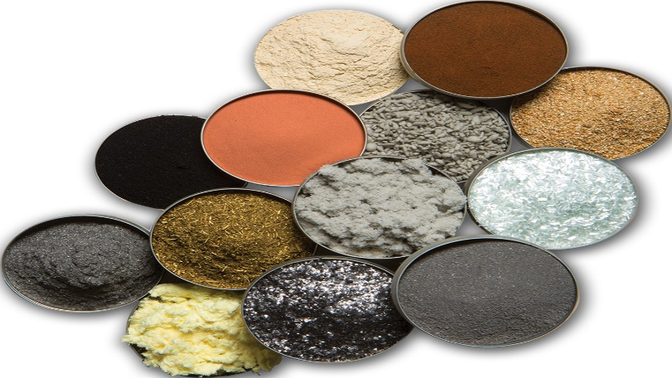
Method Validation Materials
BLANKS
Reagent Blanks
Sample or Matrix Blanks
Notes:
This presentation uses examples for chemical methods, but the following examples can be extrapolated to apply to identification, microbiological methods, medical device and manufacturing validations.
Use of various types of blanks for method validation enables assessment of how much of the measured signal is attributable to the analyte and how much to other causes or interferences. Various types of blank are available to the analyst:
Reagent blanks: Reagents used during the analytical process (including solvents used for extraction or dissolution) are analyzed in order to determine whether they contribute to the measurement signal. This type of blank incorporates all reagents used in the method and is subjected to all sample processing operations. It serves to verify that reagents are analyte free and the equipment used does not interfere with or affect the analytical signal.
Sample or Matrix Blanks: If available, matrix blanks are essential sample matrices with no analyte present, e.g. a human urine sample without a specific drug of abuse, or a sample of meat without hormone residues. Sample blanks may be difficult to obtain but such materials are necessary to give a realistic estimate of interferences that would be encountered in the analysis of test samples. Matrix blanks are used to establish background level (presence or absence) of analyte(s) and to verify that sample matrix and equipment used does not interfere with or affect the analytical signal.

Slide 18
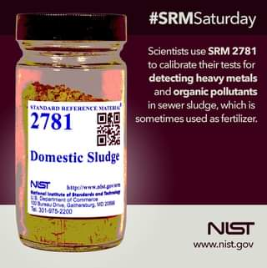
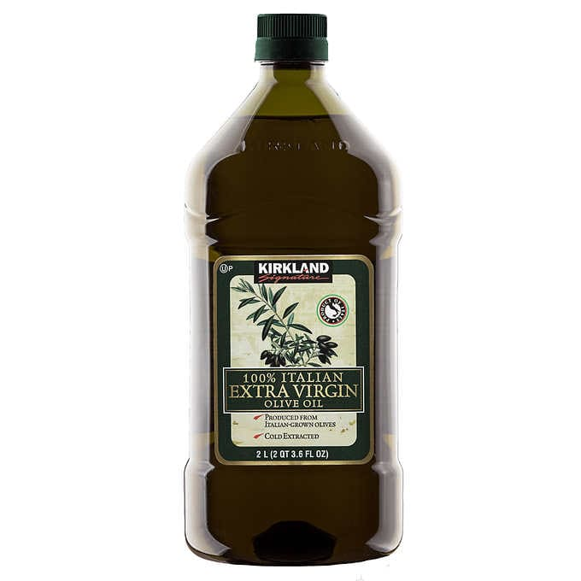
Method Validation Materials
REFERENCE SAMPLES
Certified Reference Material (CRM)
Laboratory Control Sample (LCS)
Notes:
CRM
The use of known certified reference materials (when available and applicable) should be incorporated as a quality control measure to assess the accuracy or bias of the method, as well as for obtaining information on interferences.
LCS
It is common that an appropriate certified reference material is not available or cost prohibitive to include in an investigation or analysis. A laboratory control sample, or LCS, can be utilized in place of a certified reference material, if necessary or appropriate. Typically, an LCS is tested by at least one other laboratory that uses the same method to verify the results of the testing laboratory.

Slide 19
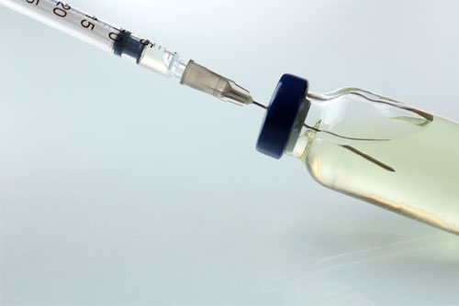
Method Validation Materials
FORTIFIED SAMPLES
Spiked Blanks
Standard Addition
Notes:
Some samples may have components that interfere with or prevent the method from preforming as developed, so evaluation of recovery is necessary for both method validation and routine analysis.
Fortified samples are prepared by the laboratory have a know portion of the target analyte that is added to a sample of material that is identical in composition but without the target analyte.
If a matrix blank is not available, a known quantity of the analyte can be added to the sample at 100% of the expected concentration, and then diluted 1:1 before analysis to ensure that the instrument response is within the analytical range of the method.

Slide 20
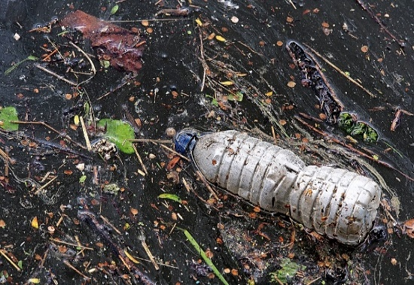

Method Validation Materials
INCURRED SAMPLES
Contaminants
Active Ingredient
Notes:
Incurred samples contain a concentration of the target analyte that is inherent to the environmental conditions, production and/or processing of a sample. Examples include:
Soil that may contain heavy metals from waste water that is illegally managed,
Edible tissue could have residue-level accumulation of veterinary drugs fed to the animal, and
Rosemary contains carnosic acid, a potent antioxidant preservative that can be used in food products.
Incurred samples have to be acquired by or provided to the laboratory for method validation and process controls, and they can be fortified with a known quantity of the target analyte to investigate or monitor analyte recovery.

Slide 21
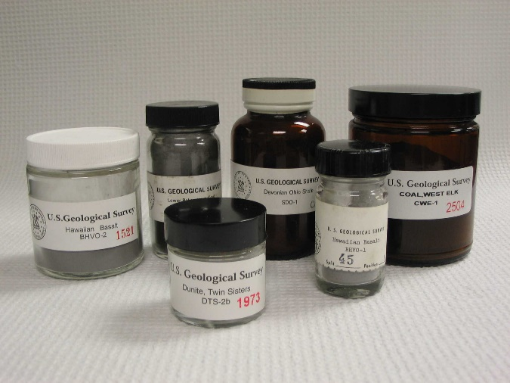
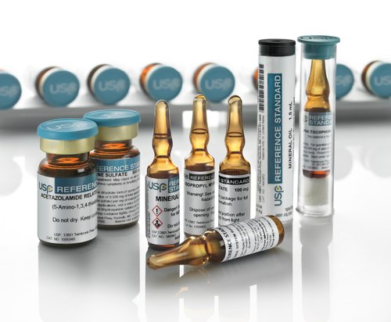
Method Validation Materials
REFERENCE STANDARDS
Reference Material
Certified Reference Standard
Notes:
Reference Material (RM) - Reference Material is sufficiently homogeneous and stable with respect to one or more specified properties, which has been established to be fit for its intended use in a measurement process
Properties can be quantitative or qualitative, e.g. identity of substances or species.
Uses may include the calibration of a measurement system, assessment of a measurement procedure, assigning values to other materials, and quality control.
A single RM cannot be used for both calibration and validation of results in the same measurement procedure.
A common use reference material is for use as or in quality control sample preparations.
Certified Reference Standards - are a type of reference material characterized by a metrologically valid procedure for one or more specified properties, accompanied by a certificate that provides the value of the specified property, its associated uncertainty, and a statement of metrological traceability. Certified reference standards and analytical reference standards accompanied by a certificate of analysis from an approved vendor can be used for calibrations and preparation of quality control samples.

Slide 22
Method Performance Characteristics
Performance Characteristic
Selectivity
Sensitivity; Limit of Detection (LOD) and Limit of Quantification (LOQ)
Analytical Range
Accuracy
Precision; Repeatability, Intermediate Precision, Reproducibility
Robustness
Notes:
These are the typical performance characteristics for chemical methods. Some qualitative methods and identification methods will not share all performance parameters.

Slide 23

Statistics
Statistical methods are utilized for summarizing data appropriately for making objective judgements
Statistical methods are used for the evaluation of precision, accuracy, LOD, LOQ, bias and measurement uncertainty.
Notes:
Statistical methods are utilized for summarizing data appropriately for making objective judgements.
Validation data is evaluated against a set of criteria that asses the method:
precision, as relative standard deviation (RSD) or coefficient of variation (CV),
accuracy, as percent accuracy in laboratory samples or recovery in fortified samples, and
LOD, LOQ, and bias.

Slide 24
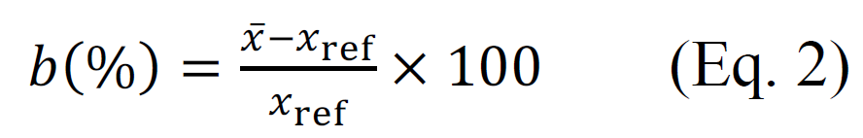
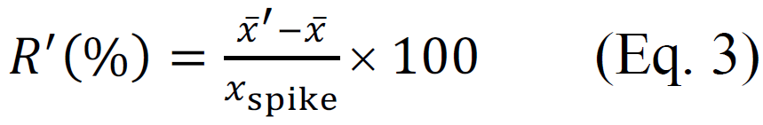
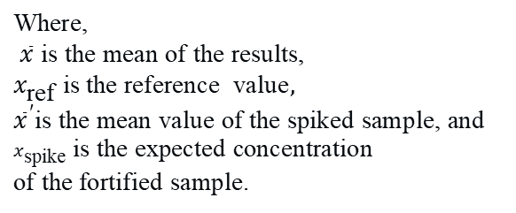
Determination of Bias
The bias can be expressed in absolute terms, as shown in Equation 1, or
Relative, as percent shown in Equation 2, or
As a relative recovery from a “spiked” or fortified sample, as shown in Equation 3
x
$$\text{Where}\text{,}$$
$$\overline{x} \text{is} \text{the} \text{mean} \text{of} \text{the} \text{results}\text{,}$$
$x_{\text{ref}} \text{is} \text{the} \text{reference}$ $\text{value},$
$${\overline{x}}^{′}\text{is} \text{the} \text{mean} \text{value} \text{of} \text{the} \text{spiked} \text{sample}\text{, }\text{and}$$
$x_{\text{spike}}$ $\text{is} \text{the} \text{expected} \text{concentration}$
$$\text{of} \text{the} \text{fortified} \text{sample}\text{. }$$
Notes:
Bias is the total systematic error, and there may be one or more systematic error components contributing to the bias.
Bias is calculated as the difference between the expectation of the test result and the true value or accepted reference value, and can be expressed in absolute terms, as percent or as relative to recovery from a fortified sample.

Slide 25
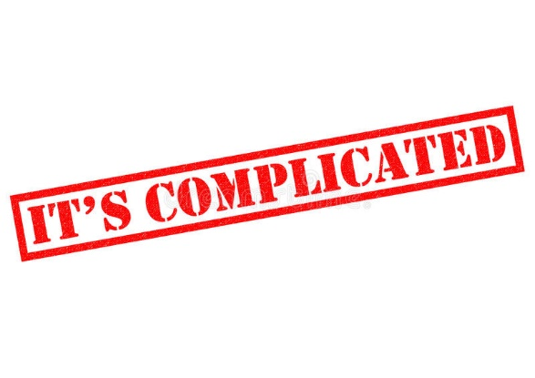
Measurement Uncertainty (MU)
There are many contributions to measurement uncertainty.
The calculation of MU depends on the effects that are impacting the result.
The uncertainties for each effect are combined for MU.
Refer to ISO 21748:2017, Guidance for the use of repeatability, reproducibility and trueness estimates in measurement uncertainty evaluation.
Notes:
Measurement or Method Uncertainty is not typically calculated as part of a method validation, but it can be useful parameter for the monitoring of routine testing; however, there are contributions to measurement uncertainty from any step in the sample lifetime that has potential to influence the result. Some of the influences affecting the result happen before it reaches the laboratory, and it may be appropriate to consider only the influences that directly impact the analytical procedure and analysis.
Refer to ISO 21748:2017, Guidance for the use of repeatability, reproducibility and trueness estimates in measurement uncertainty evaluation

Slide 26
Validation Process: Linearity and Range
Calibration
Determination of the relationship between the observed analyte signal generated by the measuring/detection system and the quantity of analyte present in the sample measured. Typically, this is accomplished through the use of calibration standards containing known amounts of analyte.
Analytical Range
The interval of concentration over which the method provides suitable accuracy and precision.

Slide 27
Validation Process: Accuracy and Precision
Accuracy
The closeness of agreement between a test result and an accepted reference value. When applied to test results, accuracy includes a combination of random and systematic error. When applied to test method, accuracy refers to a combination of trueness and precision.
Precision
The closeness of agreement between independent test results obtained under specified conditions. The precision is described by statistical methods such as a standard deviation or confidence limit of test results. See also Random Error. Precision can be further classified as Repeatability, Intermediate Precision, and Reproducibility.

Slide 28
Validation Process: Selectivity and Interferences
Selectivity
The extent to which a method can determine particular analyte(s) in a mixture(s) or matrix(ces) without interferences from other components of similar behavior.
Specificity
In quantitative analysis, specificity is the ability of a method to measure analyte in the presence of components which may be expected to be present.
Interference
A positive or negative response or effect on response produced by a substance other than the analyte. Includes spectral, physical, and chemical interferences which result in a less certain or accurate measurement of the analyte.

Slide 29
Validation Process: Sensitivity
Sensitivity
Analytical sensitivity is the change in instrument response that corresponds to a change in the measured quantity. The type of instrument used for analysis is chosen based on the necessary analytical range for the procedure.
Limit of Detection (LOD)
LOQ = 3.3 x STDEV ÷ S
Limit of Quantification (LOQ)
LOQ = 10 x STDEV ÷ S
Notes:
Sensitivity is the change in instrument response which corresponds to a change in the measured quantity (e.g., analyte concentration). Sensitivity is commonly defined as the gradient of the response curve or slope of the calibration curve at a level near the LOQ.
There are numerous ways to calculate LOD and LOQ, and the technique used should be scientifically justified and defined in the validation report; however,
The Limit of Detection (LOD) is the minimum amount or concentration of analyte that can be reliably distinguished from zero. The term is usually restricted to the response of the detection system and is often referred to as the Detection Limit. When applied to the complete analytical method it is often referred to as the Method Detection Limit (MDL), and
The Limit of Quantitation (LOQ) is the minimum amount or concentration of analyte in the test sample that can be quantified with acceptable precision. Limit of quantitation (or quantification) is variously defined but must be a value greater than the MDL and should
apply to the complete analytical method.

Slide 30
Validation Process: Robustness and Ruggedness
Robustness
A measure of the capacity of an analytical procedure to remain unaffected by small but deliberate variations in method parameters and provides an indication of its reliability during normal usage.
Ruggedness
The terms ruggedness and robustness are often used interchangeably; however, method ruggedness typically related to repeatability and is a measure of the reliability or stability of the method against extraneous influencing factors. Examples include changes in personnel or instrument system.

Slide 31


Who performs a method validation?
Research and Development Institutions (e.g. universities)
Contract Research Organizations (CROs)
Manufacturing Facilities
Government and Public Welfare Organizations
Image: Lenny Kuhne/Unsplash
Notes:
After method development, the laboratory should document the research method in sufficient detail that it can be included with the method validation plan.
For chemical methods, the single-laboratory and interlaboratory comparison studies are acceptable approaches for analytical method validations. The extent of the validation requirements will also be determined based on the intended use of the method. In some cases, including emergency situations, it may be necessary for exceptions to some validation process requirements. If there are excursions from applicable guidance or regulations, or deviations from the validation plan or protocol, all examples should be listed in the beginning of the validation report.

Slide 32

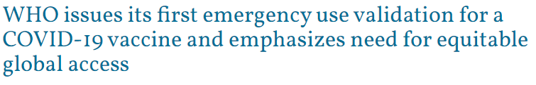
Approaches to method validation
Validation “Levels”
LEVEL 1
This is a single laboratory validation level with the lowest level of validation requirements and is appropriate for emergency or limited use.
LEVEL 2
This is a single laboratory validation level. The Laboratory that developed the method has conducted a comprehensive validation study, with performance criteria that complies with an applicable validation standard.
LEVEL 3
A multi-laboratory validation requires a minimum of one collaborating laboratory in addition to the originating laboratory. The criteria for the transferred method followed by the originating lab are at a level similar to the AOAC full collaborative study level with comparison to an existing reference method when available and appropriate.
LEVEL 4
This validation level has criteria equivalent to a full ISO or AOAC Collaborative Study.
Notes:
Several references refer to “levels” of validation. Consistently, the requirements range from a minimum of a single day of experiments with one analyst and one instrument system, to a full collaborative study, which can include many participating laboratories.
The levels defined on this slide are used by the AOAC and FDA, and it is generally accepted that results produced from methods that comply with the higher levels of validation are more reliable.

Slide 33

Approaches to method validation
Single-laboratory
A method is needed but there is not a published standard available that is fit for purpose
There is no general or universal need for a standard method or the method is proprietary
Can be validated to meet regulatory requirements if the validation was performed in compliance with applicable guidelines and/or regulations.
Notes:
When a method is needed but an applicable validated method, standard or official method is not available, a laboratory will plan a single laboratory validation, either because the request is specific to a purpose were there is no general interest or because there is some value associated with the method as intellectual property.
If the method is suitably validated to the extent specified in the applicable guidance, then it is possible for single laboratory validated methods to be utilized for producing results used for regulatory purposes.

Slide 34

Approaches to method validation
Interlaboratory
Requires a single-laboratory validated method.
Necessary for a method that is being developed for wide ranging use and/or publication.
Methods that have been validated by a standards approving organization, including, ISO, AOAC and USP, and published with performance data only need to be performance-verified.
Notes:
A collaborative study, or interlaboratory comparison are the most generally applicable for a standard method. Collaborative studies are multisite studies that are directed by a pre-approved protocol and have defined procedures and acceptance criteria. Contributing laboratories submit a report, and results are evaluated against the established acceptance criteria.
Results from a successful method trial are published and the new method is considered to be fit for purpose. After the collaborative study, a the method may be implemented by method transfer, which includes a comparative study between the reference and participating laboratory or laboratories, or by completing a compliant method performance verification.

Slide 35
Documentation Requirements
Validation Plan or Protocol
Instrument systems, software, equipment, operating parameters
SOP with sample preparation, analysis steps and special requirements
Quality and purity of chemicals, standards and solutions
Validation report
System suitability, and quality process controls for implementation of routine testing
Data reporting requirements
Notes:
Analytical procedures should be described in sufficient detail to allow a competent analyst to reproduce the necessary conditions and obtain results within the proposed acceptance criteria. Minimally, the these items and activities need to be documented in the Method Validation Report.
The specific documentation requirements depend on the applicable regulations or guidance for the testing, but the items listed in this slide include the critical components that should be included for most validations.

Slide 36
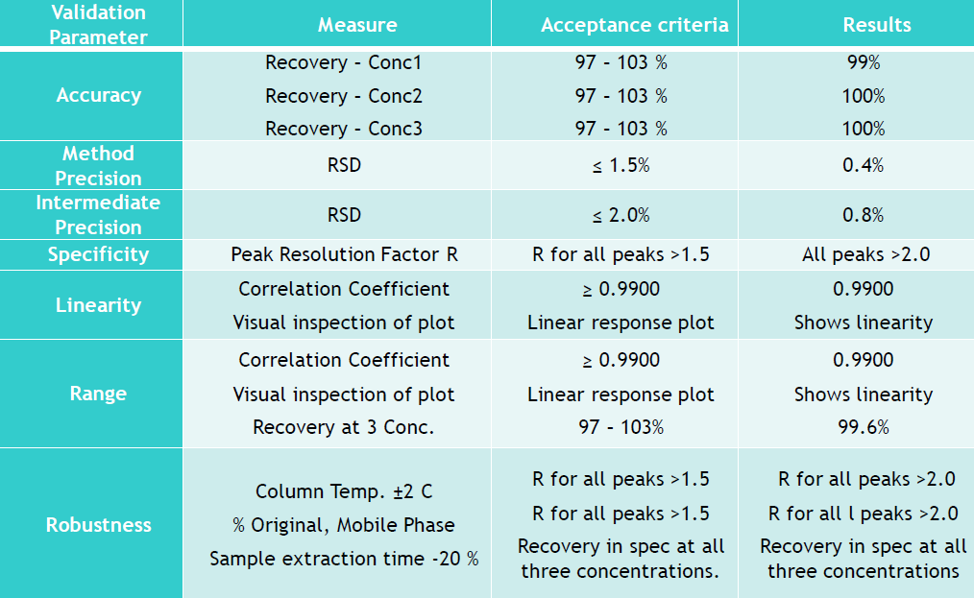
Validation Plan and Report
EXAMPLE VALIDATION DATA SUMMARY
Notes:
The validation work is performed and the results reported as directed by the validation plan or protocol. The general requirements of a validation plan or protocol and validation report are often included with applicable guidance documents, and can be used as a templates for documentation. Common and critical parts of the validation plan and report include:
A Unique Title
For chemical methods, the title should identify the analyte, method and applicable matrices.
Scope
Brief information about the method scope and a short description of the method should be given, as well as details of the status of the method (e.g. an international standard, a method developed in-house etc.), the analyte, measurement unit, types of sample and the intended use.
Experimental Design
This section should outline the purpose, which may be a single laboratory validation of a new method, verification of performance of a standard method, or an extension to the scope of a validated method. The performance characteristics which will be or were investigated should be described in detail.
Acceptance Criteria
This section should give the specifications for the performance characteristics that will be used to accept or reject the validation data.
Summary
Results should be sumarized in data tables and a concluding statement as to whether the method is fit for its intended use should be given in the report. The last section of the report should summarize the validation work and the results; however, it is not uncommon to include an “executive summary” at the beginning of the report that provides the essential details and the outcome of the validation.

Slide 37
AGENDA
Introduction
Test Method Selection and
Evaluation of Method Fitness
Method Validations
Method Performance Verifications
Maintaining Compliance

Slide 38
What is the difference between validation and verification?
Method Development, Modification or Extension
Validation
Method Publication
Method Verification
Notes:
We have now reviewed the components of a validation, and talking again about the difference between validation and verification. One way to understand the difference is to accept that a properly validated method does not need to be RE-validated. If there is a need to extend the validation to a new matrix or analyte, then the outcome is a SUPPLEMENT to the original validation. If no changes are intended, then when implementing a validated or standard method in you laboratory, it should be sufficiently verified. Some laboratories call this activity a method performance qualification, but it should not include the evaluation of robustness under typical circumstances.

Slide 39
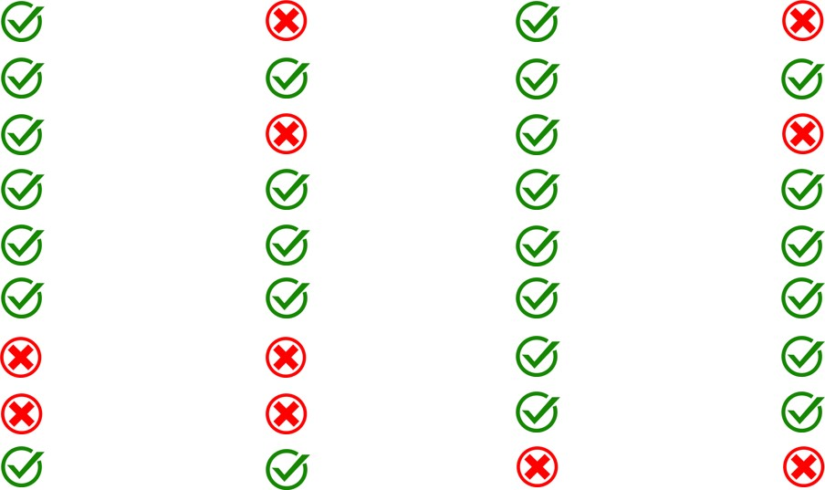
Method Verification
 | Verification |  | Validation
Parameter | Quantitative | Qualitative | Quantitative | Qualitative
Sensitivity
Specificity
Calibration
Matrix Effects
Accuracy
Repeatability
Reproducibility
Robustness
Uncertainty

Slide 40
Performance Verification of AOAC OMA 2006.01
Monensin, Narasin, and Salinomycin in
Mineral Premixes, Supplements, and Animal Feeds
Notes:
Review the original validation with compliance of ICH Q2
Perform gap analysis and perform missing validation steps prior to the transfer or method performance verification process
Base acceptance criteria on current validation studies
Document and describe the transfer or verification process in a plan or protocol
Identify methods to be used and experimental design
Identify training requirements
Identify samples and standards to be tested
Identify special transport and storage conditions
Investigate deviations from protocol
Document comparative outcome in the transfer or verification report

Slide 41
Testing for the cGMP compliant analysis of cattle feed medicated with monensin was requested.
: Performance Verification of AOAC OMA 2006.01
Confidential | Eurofins. All rights reserved.
41
Notes:
Medicated feed manufacturing facilities are required to be licensed by the FDA to produce feed containing veterinary drugs. Part of the requirement for being licensed is that the products that are produced must comply with the specification for accuracy of label claim as specified in 21 CFR Part 558.4. In order for our laboratory to provide the testing, we needed to implement a method of analysis that is capable of producing results that will be accepted for regulatory use. AOAC Official Method 2006.01 meets this requirement, and was selected for evaluation.

Slide 42
Using applicable guidance, a method performance verification plan was developed, documented and approved, which was then executed by the laboratory operations team using qualified personnel, equipment and data systems.
: Performance Verification of AOAC OMA 2006.01
Confidential | Eurofins. All rights reserved.
42
Notes:
FDA Guidance for Industry #135 defines the requirements for the validation of analytical procedures for Type C medicated feeds. Type C feeds are complete diets for animals that are intended for continuous feeding, but they contain a single or combination of veterinary drugs at a therapeutic concentration that has been approved by the FDA for a specific use. Because the FDA has approved this drug for multiple uses for multiple species, it was necessary to laboratory to verify the method performance in several different matrices.
*NOTE: Qualified personnel, equipment and data systems must be used for method performance verification as specified in 21 CFR Part 226

Slide 43
Process control checks were implemented with the new method to complete the requirements for compliant cGMP testing.
: Performance Verification of AOAC OMA 2006.01
Confidential | Eurofins. All rights reserved.
43
Notes:
After the completion of the method performance verification experiments, the data was summarized by the laboratory analysts, reviewed for accuracy and quality requirements by a scientist, and assembled as a report, which is distributed for review and approval, and maintained in compliance with local SOPs. After a quality control plan is defined and process control checks like trend charting for system suitability parameters and quality control samples are implemented, the method is ready for regulatory compliant testing.

Slide 44
AGENDA
Introduction
Test Method Selection and
Evaluation of Method Fitness
Method Validations
Method Performance Verifications
Maintaining Compliance

Slide 45

Using Validated Methods
Research methods that have not been validated may be suitable for investigational purposes, but may not be used for any testing that is subject to regulatory compliance.
To implement the validated method, an SOP or test method description should adequately describe the sample preparation and analysis procedures.
Some guidance and regulatory requirements specify more than just a validated method is needed for compliant testing.
Notes:
Note that research methods that have not been validated may be suitable for investigational purposes, but may not be used for any testing that is subject to regulatory compliance.
To implement the validated method, an SOP or test method description should adequately describe the sample preparation and analysis procedures; however, it is critical to evaluate the validation to ensure that it is fit for purpose.
Some guidance and regulatory requirements specify more than just a validated method is needed for compliant testing. You may need to have qualified instrument and computer data systems, validated LIMS system, qualified personnel and process controls and monitoring. One critical example of a process control is knowing the bottlenecks and limits for the testing in your laboratory – to consistently use the method, it is important to know how many samples can be tested at once.

Slide 46

Documentation of Validated Methods
All assessments included in the Validation Report
Documentation of all auditing and evaluations may be necessary for some regulatory purposes.
Industry-compliant Test Method Description
Notes:
The method subject to validation, is performed using a documented procedure which should be
considered a draft until the validation report is approved. Once the validation process is complete it is important to document the analytical procedure so that the method can be clearly and unambiguously implemented. There are a number of reasons for this.

Slide 47
Using Validation Data to Design a Quality Control Plan
Flowchart
Work Instructions
Checklists
Control Charts
Inspections
Document Control
Process Inspections
Data for precision, intermediate precision and reproducibility can be used to establish whether differences found when analyzing samples are significant.
For significant sources of bias, process controls should be established to minimize the bias.
Refer to the appropriate set of quality control checks and acceptance criteria that is specified in the validation report.

Slide 48
Calculating and Reporting Results
Calculate Method Uncertainty
“Not detected” results should include the LOD and/or LOQ
Reference method or method ID
Modifications or deviations must be identified and reported
Notes:
Calculate Method Uncertainty – it is better to be open and transparent about any vulnerabilities that may affect the results
“Not detected” results should include the LOD and/or LOQ.
The reference method or method ID may need to be provided in an analysis report or certificate of analysis
Modifications or deviations must be identified and reported. This includes requests to extrapolate an estimate for a result that is outside of the quantification limit – this must be noted in the report or CoA.

Slide 49
Guidance and References
Analytical Procedures and Methods Validation for Drugs and Biologics, CDER, CBER, 2015, www.fda.gov.
AOAC Guidelines for collaborative study procedures to validate characteristics of a method of analysis, 2002, www.aoac.org.
ISO Guide 33:2015 Reference materials — Good practice in using reference materials, www.iso.org.
ISO/IEC 17025:2015 General requirements for the competence of testing and calibration laboratories, www.iso.org.
ISO 21748:2010 Guidance for the use of repeatability, reproducibility and trueness estimates in measurement uncertainty estimation, www.iso.org.
Guidelines for the Validation of Chemical Methods for the FDA FVM Program, 3rd Edition, www.fda.gov.
Guidance for Industry #118, Mass Spectrometry for Confirmation of the Identity of Animal Drug Residues, US FDA CVM, 2003, www.fda.gov.
Validation of analytical procedures: Text and methodology Q2(R1), 2005, www.ich.org.
USP <1224> Transfer of Analytical Procedures, https://www.usp.org
USP <1225> Validation of Compendial Procedures, https://www.usp.org
USP <621> Chromatography, https://www.usp.org

Slide 50
WEBINAR
Navigating the Development Process for Animal Veterinary Products
Do you need a new method for an animal product?
October 2022, RSVP: info@euorfins.com
Presenters:
Leo Schilling M.Sc.
Eurofins Animal Health Testing,
Senior Scientific Services Manager
LeoSchilling@EurofinsUS.com
Kari Nichols
Eurofins Nutrition Analysis Center,
Analytical Services Manager
KariNichols@Eurofins.com

Slide 51

QUESTIONS?

Slide 52


